Slide 1

ICDPPC: Playing a Part in Developing Internationally Comparable Privacy Metrics
Blair Stewart: ICDPPC Secretariat, 2014-17; Convenor of ICDPPC Data Protection Metrics Working Group, 2016-
Presentation to ICDPPC-OECD Roundtable, Hong Kong, 27 September 2017

Slide 2
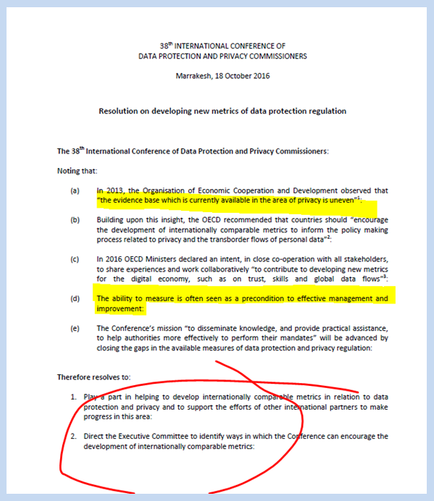
Resolution on developing New Metrics of Data Protection Regulation - 2016
Paucity of good internationally comparative measures in our regulatory field
We need measures to be effective and to improve
Resolve to do something about it with others

Slide 3

ICDPPC steps so far
Establishment of working group of 11 authorities
Useful projects identified and prioritised
Research paper on DPA breach notification statistical practices
Co-host Hong Kong Roundtable in with OECD and APPA

Slide 4
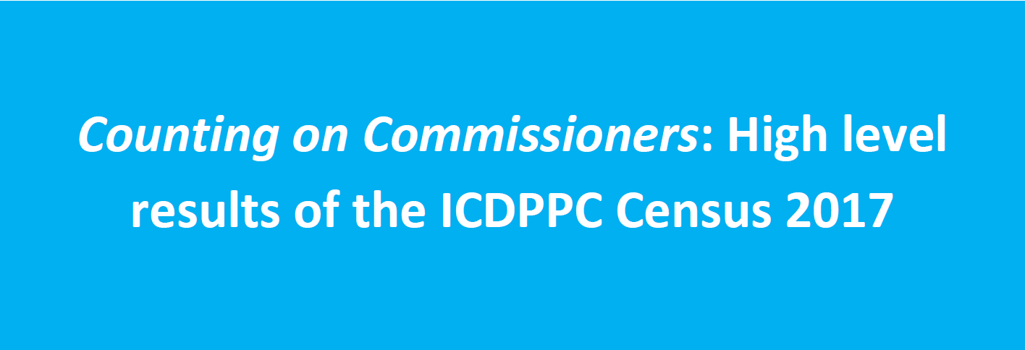
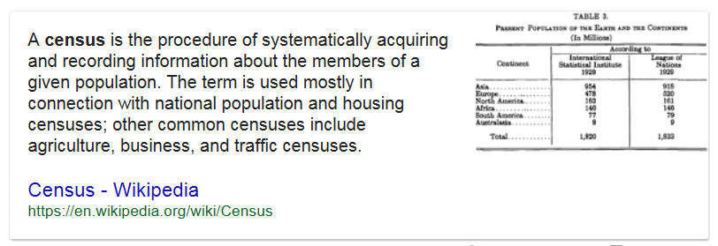
First ever ICDPPC Census
Data collection: March to June 2016
Response rate: 78% Respondents: 87 DPAs

Slide 5

ICDPPC Census 2017
Roughly 50 questions in 7 Parts:
A. Authority details
B. Data protection law, jurisdiction and exemptions
C. Funding and resources
D. Enforcement powers, case handling and reporting
E. Cross-border data flows, enforcement & cooperation
F. Breach notification
G. Other matters

Slide 6
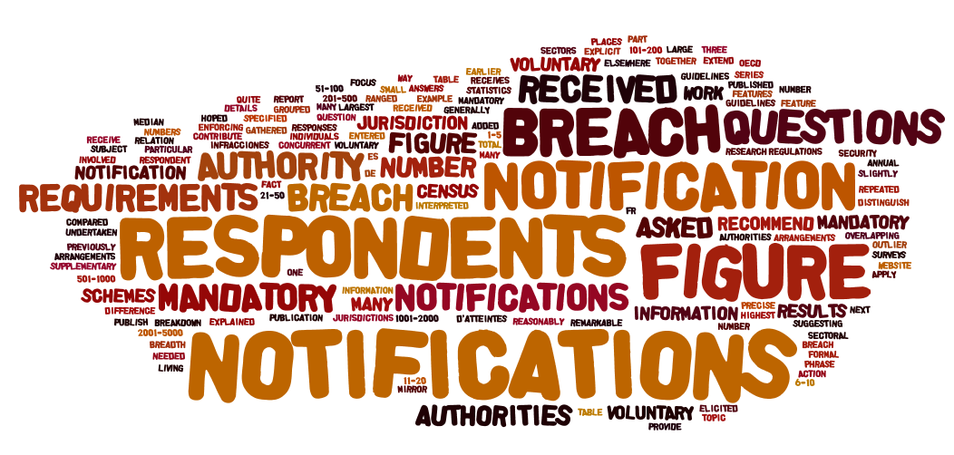
ICDPPC Census 2017
Report summarises basic results
Greater insights possible from additional analysis against demographic-type information (e.g. region and profile answers) or in combination with other data (e.g. earlier surveys, other data sets)
Provides a baseline that will be more useful when repeated to show trends and produce a longitudinal survey

Slide 7
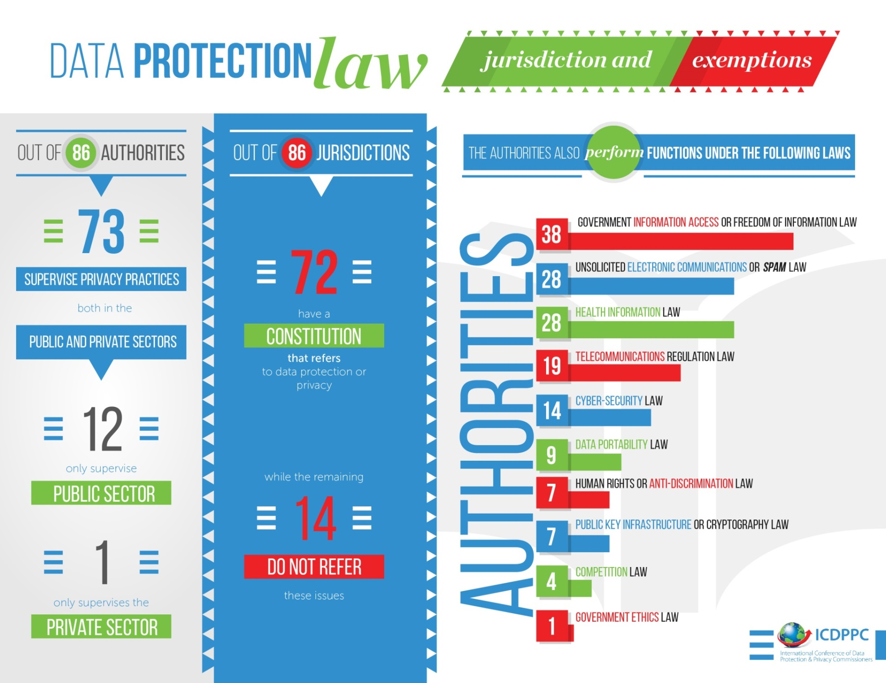
Do DPAs need to lift their game in explaining the statistics they hold?

Slide 8
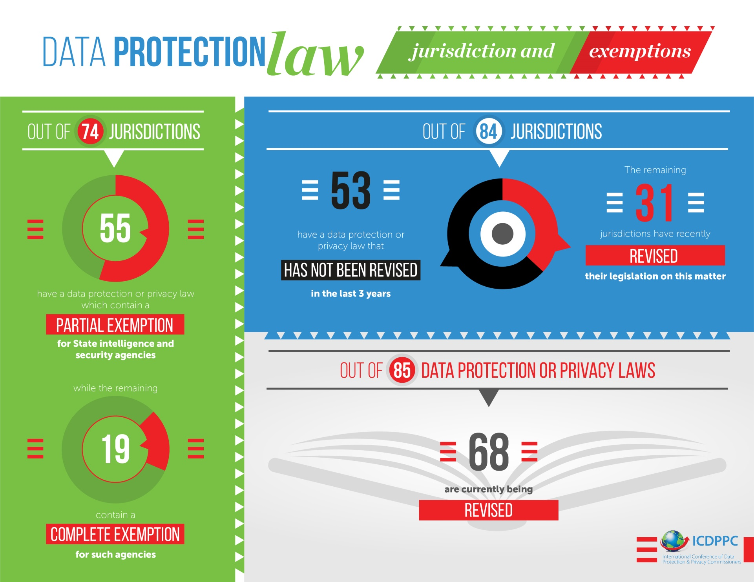

Slide 9
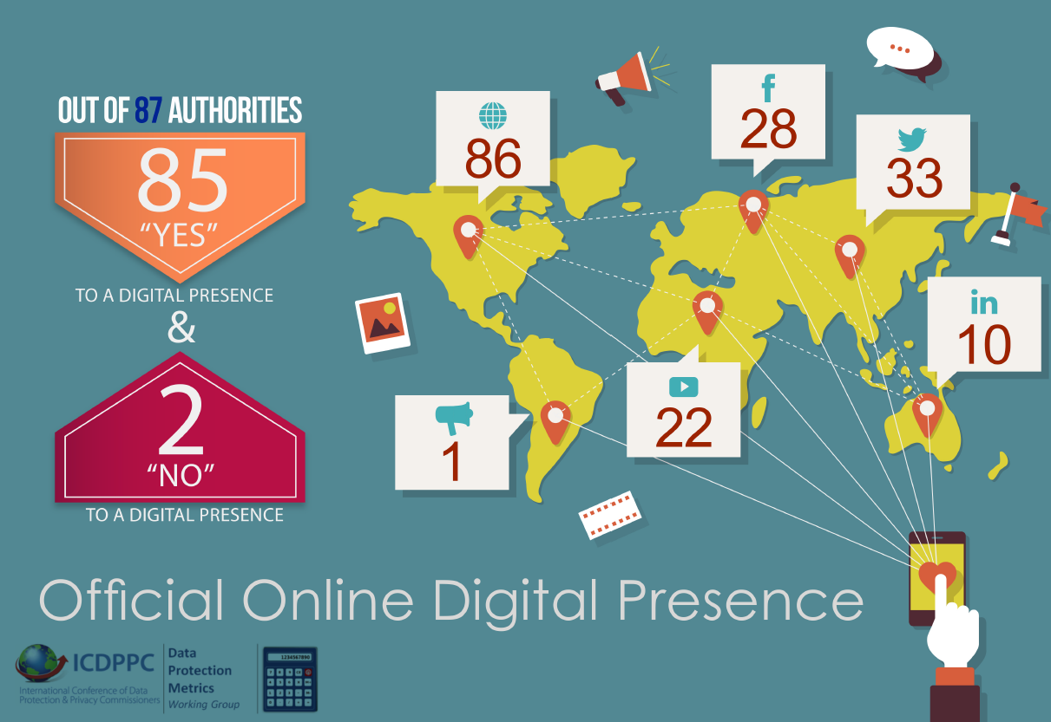

Slide 10
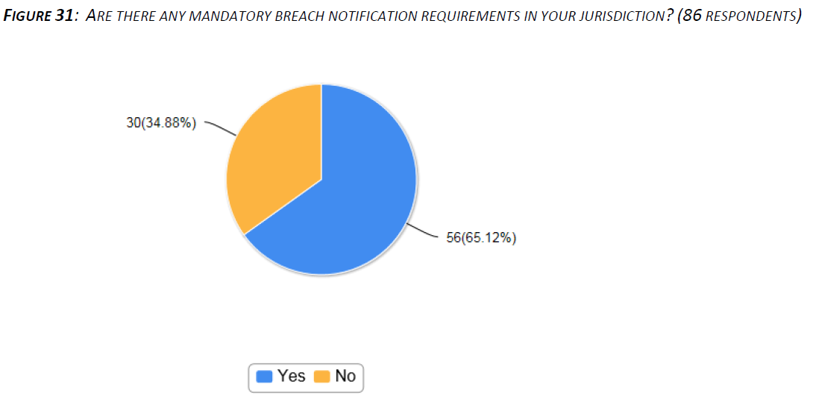
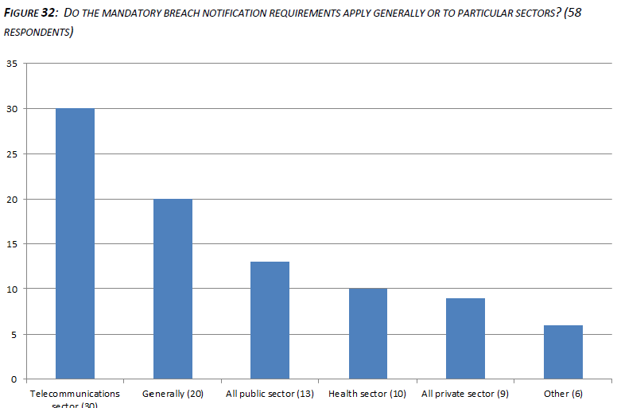
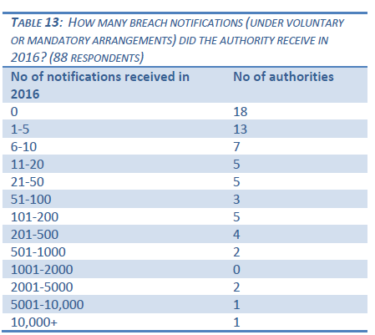
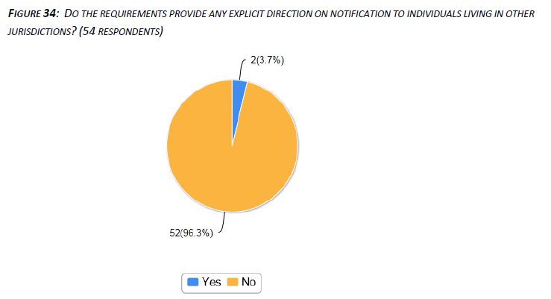
Part F: Breach notification

Slide 11
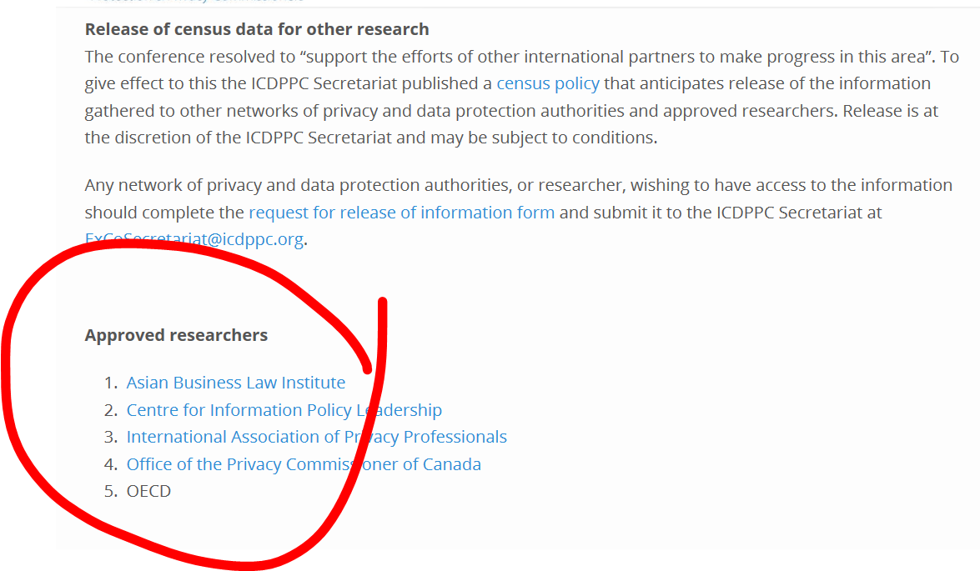
How might ICDPPC play a part?
Work with partners – e.g. as a source of data, as a user of standards developed with others e.g. on breach notification
Our own research – work on attitude surveys planned
Sharing results

